Slide 1




Haskell in Production
Not just a theory!
@danielchmbrs
@progpaintings

Slide 2
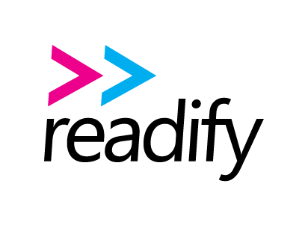


Who’s behind the beard?
Daniel Chambers
Senior Consultant at Readify
Haskelling with SEEK
@danielchmbrs
Notes:
Good afternoon everyone and thanks for coming. My name is Daniel Chambers and I’m a Senior Consultant at Readify. I’m currently working at SEEK and my team and I are writing and shipping software in Haskell.
Today I’m going to talk to you about the journey my team and I made from writing software in F# to writing software in Haskell. I’m not going drown you in a lot of Haskell code today and try to melt your brain. What I want you all to take away from this presentation is why we chose Haskell, why you might want to choose Haskell for future projects and to dispel the myth that Haskell is only academic and no good for solving real world business problems.
Let me give you a little context about the team at SEEK; SEEK has historically been writing and shipping software in .NET and over the last few years has been making the shift to the cloud and AWS. They’ve also been focussing hard on modern development practices like CI and CD and have been moving towards shipping smaller composable pieces of software faster and more reliably. They’ve been building new software as microservices and teams are given some autonomy to choose the best technologies that are fit for purpose and allow them to solve their customers problems in the most effective way.
My team works on internal software that processes job advertisements, evaluates them against many different business rules, and shuffles them between internal systems. SEEK is the market leader in Australia and so as you can imagine we deal with large amounts of data.

Slide 3
Functional Programming A Natural Choice
Composability and Reuse Functions as first class objects
Declarative Programming Lift your level of abstraction, avoid boilerplate
Purity and Immutability Function determinism, no side effects, testable
Concurrency Immutability helps eliminate race conditions
Notes:
Given the nature of this sort of work, functional programming is a natural fit. Functional programming is becoming more and more popular over time as mainstream languages like C#, C++, JavaScript and Java all adopt functional programming features and ideas. More fully functional languages like F#, Scala, Clojure are gaining popularity as people recognise the advantages that functional programming brings. Things like:
Functions as first class objects that allow you to more easily compose and reuse code in ways that make sense.
A declarative programming style that allows you to lift your level of abstraction and focus on expressing your business logic, not writing plumbing code. If you were in my Functional Programming for the Everyman talk earlier today, you would have heard me bang on about this.
Purity and immutability provide guarantees that allow you to write code that’s more testable and maintainable. Horrible global mutable state is eliminated and you can more easily reason about code when your functions are pure and have no side effects.
Immutability also gives the double benefit of making it easier to write concurrent code that is correct and without race conditions, as its not possible for two threads to mutate the same data.

Slide 4


F# Our FP Gateway
Notes:
For the first version of our software, we were in experimental mode, so we needed to be able to get a functioning prototype out quickly in order to test the waters. As I mentioned earlier, SEEK’s background is in .NET so F# was a natural fit for us. At the inception of the project, there was only one developer and we wanted to avoid rebuilding internal libraries and just reuse existing company code where possible. We had familiar tooling in Visual Studio, we could lean on our existing .NET knowledge, and F#’s mix of FP and OO made learning easier for us. F# is a great language and it allowed us to quickly ship our prototype.

Slide 5


Honeymoon Period Over Continuous Delivery
Twelve-Factor App 12factor.net – guidance for clean, portable, scalable, cloud-first apps
Immutable Infrastructure Stateless, easy to stand up and tear down
Amazon Web Services Infrastructure as a Service (IaaS)
Notes:
After we had proven out our project with our F# prototype, the next step was to productionalise it. That meant we needed to keep in line with SEEK’s focus on continuous integration and continuous delivery. We needed to be able to ship early, ship fast, measure the impact of our changes and react to them swiftly. Our application design was guided by Heroku’s 12 Factor App Methodology and we wanted our deployments to use immutable infrastructure.
Immutable infrastructure is where your servers are stateless and can be torn down and stood up again at a moments notice without risk of data or configuration loss. This simplifies application scaling and testing, as it’s easy to simply spin up new servers reproducibly. It avoids the mutable server rot situation where you end up with snowflake servers that hold implicit configuration and data and have to be fixed when something goes wrong. With immutable servers, if something goes wrong, you simply throw the server away and trivially stand up a new one. This is great in a cloud-first world where scaling up and down and running on commodity hardware that may fail is a fact of life. One concrete example of where this helped us is when we needed to make a change to a production system that would have required downtime. To avoid the downtime, we stood up an entirely new environment, which was trivial thanks to immutable infrastructure and scripts, and just switched over that environment to be production instead.
SEEK is heavily invested into AWS as a cloud provider. AWS’s strength is in Infrastructure as a Service, as opposed to Azure which focusses on Platform as a Service. AWS is also focussed on Linux and it’s support for Windows is second class in comparison to Azure. Our F# app being a .NET app, we ran it on Windows Server and ran into AWS issues like lack of Windows support for Elastic Beanstalk Worker Roles and smaller annoyances like logs written with the wrong line endings. Because we wanted immutable infrastructure, throwing away Windows VMs and starting new ones on every deployment was slow and we ended up with 20 minute deployment times. For people on Azure, its PaaS offerings overcome a lot of these issues for you and we wanted a PaaS-like experience on AWS.

Slide 6




ECS, Docker & Mono Fast Deploys, Immutable Infrastructure
EC2 Container
Service (ECS)
Notes:
The teams having the most success around SEEK in terms of being able to deploy and scale quickly, reliably and immutably were the ones using Docker. Docker and container technology allows you to have immutable infrastructure and reproducible deployments as your app is isolated from the host machine inside a container, which is immutable and thrown away after execution. Unfortunately, Docker containers are only supported on Linux. Windows Server 2016 will support them in the future, but it certainly wasn’t ready for us at the towards the end of 2015. So we investigated whether we could take our F# .NET codebase and run it in a Docker container on Linux using Mono, orchestrated by Amazon’s ECS.
Unfortunately we had horrific reliability issues with Mono and F#. The Mono runtime would inconsistently but regularly crash on us with segmentation faults, which destroyed the reliability of our system. It was strange because it seemed like when we searched about online that nobody else in the Mono & F# community was having these problems. We tried different versions of Mono, stables, betas, alphas, some better than others but we were never able to fully resolve the problem. We found that different Linux kernels made it worse, so when Amazon upgraded their ECS VM images to Linux Kernel 4.1 we started crashing 90% of the time. We also ran into annoying differences in the Mono implementation of the .NET BCL. For example ParseUri is different on Mono than on .NET and will fail and accept different URIs. We looked at .NET Core, which is new and shiny and cross platform, but unfortunately F# support was only just beginning to be worked on when we looked at it at the end of 2015.

Slide 7




Alternatives The Requirements
Static Typing Compiler should check correctness
Functional First The FP approach in F# was incredibly effective
Cross Platform Devs on Windows & Mac OS X, deploys to Linux
Active, Friendly, Sizable Community Can we get help, advice and questions answered?
Notes:
So we started to look at alternative platforms that would allow us to have immutable infrastructure and fast, reliable deployments. We had a few key requirements that had to be met.
We wanted a statically typed language – we wanted the compiler to check correctness for us, we don’t want to find bugs at runtime
We wanted a functional first language – we loved developing in F# and the functional approach had resulted in nice, readable, testable and maintainable code
We wanted something cross platform – our team consists of developers on Windows and on Macs and we needed to be able deploy using a Linux Docker container.
We wanted something with an active, friendly and sizeable community – we didn’t want to be the first blazing the trail, we wanted to be able to learn from others and get help and advice.
We considered the JVM as a platform; Clojure was out for us because it wasn’t statically typed. Scala looked alright, but we’d observed when coding in F# that F# had seemed like a functional language that included OO bits. We’d enjoyed the functional bits and found the OO-bits the least likable. Scala seemed to be another OO-flavoured functional language and smart Scala devs that we’d talked to at functional meetups had recommended that we take a look at Haskell.
We’d observed that functional fundamentals seem to be exemplified in Haskell, so we decided to look at it more closely to see if would meet our requirements.

Slide 8
What does Haskell buy us? Tossing up the pros and cons
Functional
Statically Typed
Pure & Immutable Guaranteed
Cross Platform
Active Community
Hoogle
Simple Deployment
Lazy – Seems Efficient
✗ “Haskell is a research language”
✗ Enforced Purity & Immutability Seems Hard
✗ Steep Learning Curve
✗ Weaker Tooling – No JetBrains!
✗ Less Popular than a JVM Language
✗ Lazy – Very Different
Notes:
So on the pros side, Haskell is functional. In fact, you can’t get any more functional than Haskell.
It’s statically typed, and has a very capable type inference engine meaning that we can get static types without the ceremony sometimes found in other languages.
Haskell is guaranteed pure and immutable. There is no such thing as mutable variables you can turn on, like in F#.
It’s cross-platform and supports Windows, OSX and Linux
It has an active community, who seem to hang out on Reddit, IRC, Slack and Stack Overflow.
It has Hoogle, which is a type-driven search engine. We’ll see this in action later, and it’s super cool.
It affords simple deployment since Haskell executables are statically linked and so can be easily deployed by simply copying them.
The language is lazy, unlike most other languages that are strict. This means things aren’t evaluated until their value is really needed, which on the face of it, seems efficient.
On the cons side, Haskell has a reputation for being a research language; we weren’t really sure what to think there; is this a bad thing?
Enforced purity and immutability seemed hard to us; what if we needed an escape hatch?
Haskell itself seemed like a hard language, with many things for us to learn in order to be productive.
Haskell’s tooling seemed pretty weak in comparison to .NET and the JVM, both of which have JetBrains making incredible refactoring and performance tools.
Even though Haskell’s community was active, it was less popular than the JVM. We might need to blaze more trails.
Laziness was very different to normal strictness we didn’t really know what to expect when working in a completely different execution model.

Slide 9

SEEK Hackathon Three days in the Haskell deep end
Four Developers No real Haskell experience, outside of toy exercises
Challenges Many alternative libraries makes best choice unclear
“New users may feel overwhelmed with the various options that are available to them.” - https://wiki.haskell.org/Regular_expressions
Notes:
In November, SEEK held its biannual internal Hackathon where employees are encouraged to experiment and try out ideas they’ve had. So the team decided to give Haskell a shot by porting the core logic of our application from F# to Haskell. At the time there were four devs on the team and none of us had written a line of real Haskell outside of toy exercises before. We split the application into three pieces, one of us investigated how to make HTTP requests, two of us on porting key business logic, and the last guy on how to read our input data from CSVs from Amazon S3.
There was a lot for us to learn, but our F# experience served us well, and we mainly just focused on how to do the same thing we’d done in F# in Haskell. That led us to doing some stylistic things we later learned are not Haskellish, but it was a good on-ramp, and it showed that our general functional knowledge was transferrable.
Now, this is not to say there were no challenges doing the port. Haskell has a long history and many libraries available. One that bit us pretty hard was regular expressions. We expected to be to able to copy paste our regexs across, but it turned out that there’s a whole bunch of different regex libraries. The Haskell community often tends to present all options and let you figure out what’s best, which is pretty hard when you’re new. Here’s a case in point from the documentation. “New users may feel overwhelmed with the various options that are available to them.” You don’t say? We ended up having to try each one until we found one that worked for us, which was a bit frustrating.

Slide 10

SEEK Hackathon Three days in the Haskell deep end
Four Developers No real Haskell experience, outside of toy exercises
Challenges Haskell compiler errors are initially scary
Couldn't match type `[String]'
with `((Options -> Options)
-> Const (Options -> Options) (Options -> Options))
-> (([Text] -> f0 [Text]) -> Options -> f0 Options)
-> Const
(Options -> Options)
(([Text] -> f0 [Text]) -> Options -> f0 Options)'
Expected type: Getting
(Options -> Options)
(([Text] -> f0 [Text]) -> Options -> f0 Options)
(Options -> Options)
Actual type: [String]
In the second argument of `(^.)', namely `["CreateDate"]'
In the second argument of `(&)', namely
`param "sortBy" ^. ["CreateDate"]'
In the first argument of `(&)', namely
`defaults & withCommonHeaders
...
Notes:
Another challenge was interpreting Haskell compiler errors. They are extremely detailed and print out a lot of text and are quite intimidating on first sight. We soon learned that they might look overwhelming, but if you read them carefully, they’re actually quite understandable, and often it’s only the first bit you need to care about. Another thing that we learned is that it’s often easier to make small changes from a successfully compiling state and then fix any compiler errors, because then the errors are localised and easier to understand in the context of your small change.

Slide 11

SEEK Hackathon Three days in the Haskell deep end
Notes:
Challenges overcome, after three days in the deep end, we had successfully ported the core logic and tests of the application from F# to Haskell, and had tested out HTTP communication, JSON serialization and CSV reading from Amazon S3. The team was really happy with Haskell and found their skills and code from F# had transferred across pretty cleanly. There were areas in the code that were quite different, particularly around anything to do with IO, but the core business logic code looked quite similar to the F# code. We were pleasantly surprised by some of the Haskell libraries, especially the Amazonka library that allows you to program against AWS services like S3 and DynamoDB. Amazonka presented a much nicer API surface than Amazon’s own .NET SDK did, with cool features like a clean and reusuable way to do pagination.

Slide 12

Journey to Production Parallel Port to Haskell
November 2015 Successful Haskell Hackathon
December 2015 Started parallel port to Haskell (v2)
Late March 2016 Dry Run validation to compare results against v1
Early April 2016 Switched over to Haskell in production. v1 switched to Dry Run
May 2016 Decommissioned v1
Notes:
So with November’s hackathon result giving us confidence in Haskell’s suitability for our application, in December we made a decision to start a proper port to Haskell based on the code we wrote in the Hackathon. Keep in mind that we were porting a microservice, so we’re not talking about porting a huge 5 year old monolith codebase. We decided to initially keep the code structure similar to the F# version except for a few key areas where we wanted to support new features around our ability to track metrics about the results of processing runs.
We performed the development in parallel with the F# version so we could continue adding minor features to the v1 prototype system. Not all developers were on the Haskell port at this point. However, by the end of January, all developers had moved across to the Haskell port effort and by late March we were ready to run the system in dry run mode and compare its results with the v1 system to make sure that it did the same things.
That went successfully, so in early April we switched over to the v2 Haskell system and switched v1 into dry run mode so we could continue to monitor. We bravely made the switchover on a Friday afternoon, and half expected to see issues over the weekend, but the new Haskell system hummed along perfectly. In May we finally decommissioned the v1 system and deleted all its servers.
Success! Haskell in production, using immutable infrastructure based on AWS ECS, Docker and Linux. Our deployment times are around five minutes, and we’re in full continuous delivery mode where every commit to master autodeploys to production. We were all Haskell beginners when we started, and now we’re probably Haskell intermediates. None of us are super Haskell experts, but that hasn’t stopped us from shipping good, useful software.

Slide 13
Okay, that’s cool. But what’s it actually like to code in Haskell?
Notes:
So you’re probably thinking, that’s cool, but what’s it really like to code in Haskell?

Slide 14

Static Typing
“If it compiles, it probably works!” Program correctness tested by the compiler
Express constraints in terms of types Eliminate ambiguity and edge cases
Maybe a
Indicates a value of type a may (Just a) or may not (Nothing) exist
NonEmpty a
A list that must have at least one item of type a in it
Types often describe what a function does Self documenting and enforce correct use
Not in Haskell
zip :: [a] -> [b] -> [(a, b)]
Notes:
Haskell is a statically typed language. This means it has a type system that is enforced and checked by the compiler at compile time. As a consequence, Haskell forces you to write code that is correct and rejects code that is not, unlike a dynamically typed language which leaves type correctness checks until runtime. While this may seem arduous as you write code in comparison to a dynamically typed language, what it means is you spend much much less type debugging errors at runtime. It’s somewhat an in-joke that with Haskell, “if it compiles, it probably works” but we’ve found that to be the case far more often than not.
As an example, we had a new team member join the team and learn Haskell, and on while working on his first major pull request, after he made all his changes he got everything to compile, ran the tests and everything passed. He was so surprised that nothing was broken, he didn’t believe it and went back to check that everything was okay in the tests. It was.
Static typing means that you can express your program constraints in terms of types and have them automatically checked by the compiler, rather than manually by you in unit tests. Haskell has many common types already implemented, ready for you to use. One example is the Maybe type (which F# people will recognise as the Option type), which allows you to indicate that a value may or may not exist at runtime. This one type eliminates a whole class of bugs that are people’s favourite: the NullReferenceException. The Maybe type allows you to opt into “nullness” and forces the developer to deal with it properly. This is opposed to the usual approach of allowing nulls everywhere and having to manually write checks to “opt out” of nullness.
The NonEmpty type is a list that must have at least one item in it. This helps get rid of APIs that take a List but throw if you don’t have anything in the list. NonEmpty makes sure that this is enforced by the compiler and handled correctly by the developer. It is impossible to create a NonEmpty list that has nothing in it, so you know in the code that you never need to manually write those checks.
Types often describe what a function does, which means they actually act as a form of documentation for the code. For example, take a look at the zip function type signature that is on the slide; what does that function do? Well, when you understand Haskell types, you can see that it’s a function that takes two lists (List is the square brackets), one of “a” values, one of “b” values, and returns a list of tuples made of up “a” and “b” values (tuples is the parenthesis and comma). “a” and “b” are type parameters, so they can be any type, an Int, String, whatever. Just by looking at this type signature, we can infer that this function combines those two lists into a single list by zipping together each element pair into a tuple.

Slide 15
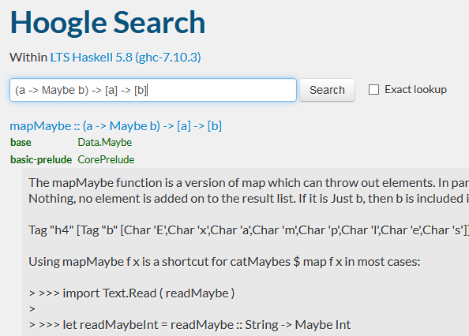

Static Typing
Hoogle Find a function by type
Function that transforms each item in a list and
only keeps some of them
(a -> Maybe b) -> [a] -> [b]
Notes:
This descriptiveness that the type system provides gives unexpected benefits. The Haskell ecosystem has a search engine called Hoogle which allows you to search for functions by their type signatures. Let’s try an example.
Imagine we want a function that takes a list and transforms each element and also filters the list at the same time. F# people might recognise this as the “choose” function, but we initially didn’t know what the equivalent was in Haskell when we did our port. Enter Hoogle! We wrote out the type signature for the function. The first parameter is a function that transforms each element a to b, and optionally can discard them, which the Maybe type represents (Maybe we’ll keep the element or not). The second parameter is the input list of “a”s, and the return type is a list of transformed “b”s.
When we put this into Hoogle, it immediately returns a set of matching functions and right at the top is the one we want: the mapMaybe function from the Data.Maybe module. That’s pretty cool!
Hoogle is incredibly useful to see whether there’s a function out there that does what you need, rather than you implementing it yourself. A lot of the time, you’ll be able to pull in a library that does what you want. It’s also super useful when you’re learning and you don’t know where all the basic functions are. You can just ask Hoogle, “I need a function that does ‘this’”, and it gives you a list of matching functions.

Slide 16

Purity and Immutability Guaranteed by the compiler
Every value is immutable Functions are guaranteed to be pure
Purity:
When given the same input values a function returns the same output value and cannot modify its input values (no side effects)
No invisible global mutable state Easier to reason about code, more maintainable
Increased testability Results of function calls are trivially reproducible
Simplified concurrency Race conditions caused by mutability eliminated
Haskell is 100% pure!
Notes:
There is no mutability in Haskell, every value is immutable. There is no mutable flag that you can turn on, like in F#. This means your functions are guaranteed to be pure, which means that when those functions are given the same input values they will always return the same output values, and additionally they can’t modify their input values (ie no side effects allowed). Because this is enforced by the compiler, you gain additional trust in the functions that you are calling. You no longer have to worry about what a function will do when you pass it something; you don’t need to dig inside it to make sure it’s not doing something dirty. The guarantee of function purity ensures this for you.
When functions can’t have side effects, this means that your pure code cannot have invisible global mutable state. This makes it much easier to reason about the code because you can see its inputs in function signatures, and know that it’s not reading and writing state in some magic static variable somewhere, the likes of which you might find in an OO code base. When your code is easier to reason about, it is more maintainable.
When our functions are pure and have no side effects, testing them becomes much easier because the results of function calls are naturally reproducible. You also don’t need to worry about that classic unit testing mistake where tests share state and then when they are run in a different order, they suddenly start failing. That sort of thing is prevented in Haskell by purity and immutability.
Dealing with concurrency is also simplified by the elimination of mutability. The classic race condition where two threads read and write the same state and trip over each other in unexpected and non-deterministic ways is not possible when mutable state is not allowed. The programmer is forced to more cleanly split and join parallel processes.

Slide 17
Purity in an Impure World Managing impurity in Haskell
getCurrentTime :: () -> UTCTime
Impossible in Haskell
getCurrentTime :: IO UTCTime
getCurrentTime :: () -> IO UTCTime
This function is still pure
currentPlus10Seconds :: IO UTCTime currentPlus10Seconds = getCurrentTime >>= \currentTime -> pure $ seconds 10 `addUTCTime` currentTime
Lambda function
Bind: function on the right is called with the value “inside” IO
main :: IO () main = currentPlus10Seconds >>= print
Prints to the console
Notes:
Purity is all well and good, but your program is useless unless it can actually do some side effects and affect the real world. So if Haskell’s so pure, how do we manage impurity? A function for getting the current time is a good simple example. On the slide is a function that takes unit (eg void) and returns the current time. However, this function is impossible in Haskell since for that function to return a different UTCTime each time it is called with the same input value (unit), it would have to violate purity.
This is where Haskell’s IO monad comes in. The IO monad allows us to write impure code in a pure way. So our getCurrentTime function would look like this instead; it would return an IO of UTCTime. In fact, because of purity, that function would always have to return the same value anyway, so we can drop the input parameter and just have a value instead of a function, and that value is of type IO of UTCTime.
So how can we use this? Well, let’s write something that calculates the current time plus 10 seconds. To do this, we can use the “bind” operator, which allows us to hook a function up to receive the value “inside” the IO. Here’s we’re using a lambda function that will take the current time value and add 10 seconds to it. This lambda function itself is still pure code. Given the same time, it’ll still return the same value. The IO type in the signature is a big signal to the developer that there’s impure stuff going on in this code, which is a bonus for the code readability.
IO values are just potential values; to actually run them and see them do IO, we need to hook them up to the real world. We can do this by hooking them up the program’s main entry point. In this case up on the slide, we’ve got a little program that reads the current time, adds 10 seconds to it, and then prints that to the console and quits.

Slide 18
Purity in an Impure World Managing impurity in Haskell
IO
Purity
plus10Seconds :: UTCTime -> UTCTime plus10Seconds currentTime =
seconds 10 `addUTCTime` currentTime
currentPlus10Seconds :: IO UTCTime currentPlus10Seconds = getCurrentTime >>= plus10Seconds
Notes:
So we can now affect the real world by using the IO monad. However, this doesn’t mean we want to do our entire program inside IO. What we want to achieve is the majority of our code to be written outside of IO in a pure fashion, and then we connect its edges up to the real world with a little IO. In other words we want to push our IO to the edges of our application. This makes our code a lot easier to test and reason about.
Here’s a micro example of how we could cut our previous code up in order to keep the IO bits separate from the actual program logic. Notice how we’ve pulled our pure lambda out into a separate function. We can test and reason about that easily now.
Seeing the IO type on functions and values is an instant indication that some sort of side effects are going on in that code. This makes the division between impure and pure code very obvious and not a nasty surprise to the developer.

Slide 19

Optimised for Functional Programming
Less non-functional baggage Functional-first
Special garbage collector Optimised to collect a lot of garbage
Newtypes Wrapper types without the runtime cost
newtype Email = Email String
Functional libraries No compromises
Notes:
The nice thing about programming in Haskell is that Haskell is a functional-first language. Often other functional languages come with the baggage of the non-FP platforms they’re built on. For example, Scala doesn’t support mutually recursive functions because the JVM doesn’t have tail calls. This means that recursion, which is a key functional technique, needs to be handled with care and often worked around with a technique called trampolining. F# doesn’t support higher-kinded types, because .NET’s generics system doesn’t support them. Haskell’s runtime was built with functional programming in mind and doesn’t have either of these two limitations.
Haskell’s runtime includes a special garbage collector that is built to handle the generation and collection of lots of garbage. Because everything’s immutable in Haskell, a lot of intermediate garbage values are created in typical programs. Haskell’s garbage collector can take advantage of the guarantees that function purity provides and uses techniques that ensure that lots of garbage that’s generated then discarded in a short amount of time costs very little to dispose of.
Haskell has a language feature called newtypes that allow you create wrappers around types that are effectively erased at compile time so you get them for free at runtime. As an example, you might make a newtype wrapper around a String for Email addresses. In F#, that wrapper type would incur a memory allocation and garbage collection cost, but in Haskell wanting to do that is so common that they’ve specifically optimised for it.
One of the advantages of using F# is that you can lean on the entire of the .NET ecosystem for libraries. The downside of this is that often you’ll be dealing with OO-style libraries that love their mutability, when you’d rather deal with an FP-style library that uses functional types like Option and works in an immutable fashion. In Haskell, all the libraries are functional and immutable, so you don’t have to compromise.

Slide 20
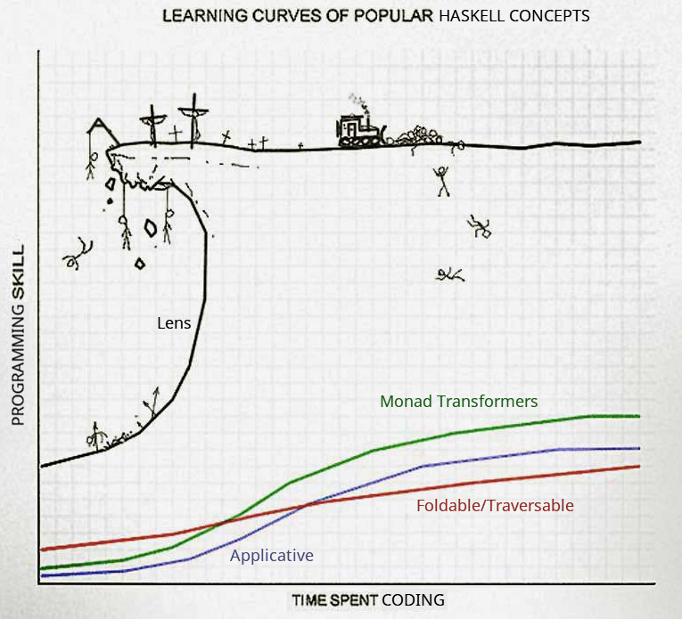
Learning Curve Understanding the cray-cray
Steep learning curve Upfront learning required
Real programs require: Functor Applicative Monad (IO, State, Maybe, Either, Reader, Writer)
Monad Transformers
Foldable
Not insurmountable! Does not require a maths background!
Notes:
The learning curve of Haskell is one of it’s disadvantages. Learning a language like F# is easier because it’s a hybrid language with OO, which let’s you lean on your previous knowledge as you adopt and get used to the new functional bits. Because Haskell enforces purity and immutability, and is a lazy language, writing real programs in it can be quite different to other languages. This means there’s can be a lot of upfront learning that you need to do to learn how to do things in a pure functional way. However, we shouldn’t be surprised that this is the case, and it’s unfair to compare it in the same way as you might compare a C# developer picking up JavaScript. While C# and JavaScript have their differences, the syntax is still C-based and they’re still both imperative, mutable, strict-evaluation languages. Haskell is much more different, in that it’s not C-based, is functional, immutable and has lazy evaluation; so naturally things are going to be different!
Another perspective on this is that learning functional programming properly is actually easier in Haskell, because the whole language is geared for it and so libraries and examples are always done in a pure functional style. Of course, because pure FP is quite different to imperative programming, it’ll take a bit of learning to adjust, but you’ll come out with a more sound understanding of FP at the end.
Real Haskell programs require you to pick up many different functional concepts, such as Functors, Applicatives, Monad (of which there are many, such as IO, State, Maybe, Either, Reader, Writer), Monad Transformers and Foldable. There’s lots of new things to learn, but all of them are helpful abstractions that soon become as familiar as the strategy pattern is in OO. Don’t try to reach for your OO abstractions; instead think about what problem they’re originally solving and find out how that’s solved using functional techniques instead. For example, in FP dependency injection is just function composition.
It is important to realise that getting over Haskell’s learning curve is absolutely an achievable task. While concepts like monads and functors sound scary, you don’t need to be a genius or a maths guy to understand them. There are plenty of good tutorials online and books to read that explain what they are, how they work and why you’d used them. I’ll recommend a few at the end. These abstractions aren’t just academic and learning them is an investment that pays off, as they allow you to write declarative code that has minimal plumbing and that expresses intention. Haskell is a very deep language; don’t measure your progress by seeing how far you are away from knowing everything; instead focus on whether you know what you need to to solve your problems.

Slide 21

Tooling Stack
Manages dependencies and compilation
Downloads compiler and libraries, builds and tests your code
LTS (Long Term Support) Branches Eliminates dependency hell and global versioning
Cross-platform
Works on Windows/Mac OS/Linux
Notes:
Tooling is one of Haskell’s weaker areas. It doesn’t have the profusion of IDEs, profilers, and other tooling that an ecosystem like .NET or Java has. However, Haskell has got a lot better over the last few years. Managing different versions of the Haskell compiler and library versions used to be painful in the past. Developers who use NodeJS are probably familiar with issues like NodeJS runtime versions, libraries with clashing versions, globally installed libraries and tools clashing between projects.
However, in Haskell-land these sorts of issues have been solved with a tool called Stack. Stack is a relatively new tool in the Haskell ecosystem and it has rocketed to popularity. Stack is a bit like NVM and NPM combined. It downloads the Haskell compiler and the libraries your project needs, and manages building and testing your code.
Stack eliminates versioning and dependency hell by fixing the versions of the compiler and libraries in a branch called an LTS. You tie your Haskell project to a particular LTS version, and Stack automatically acquires the correct version of the compiler, and uses the correct versions of libraries that all work together. The Stack maintainers regularly release new LTSs to include newer library and compiler versions, and they’ve already done the work to make sure everything works together properly. You never need to resolve another version conflict yourself again. You can work on two projects that use two different LTSs and Stack manages the versioning for you transparently.
Stack has also made cross platform development just work. I remember playing with Haskell before Stack existed and getting things to work on Windows was painful, with some packages not even compiling. This time around, with Stack, I’ve had no issues, and we have devs on MacOS as well, plus we build and run on Linux for CI and production.

Slide 22

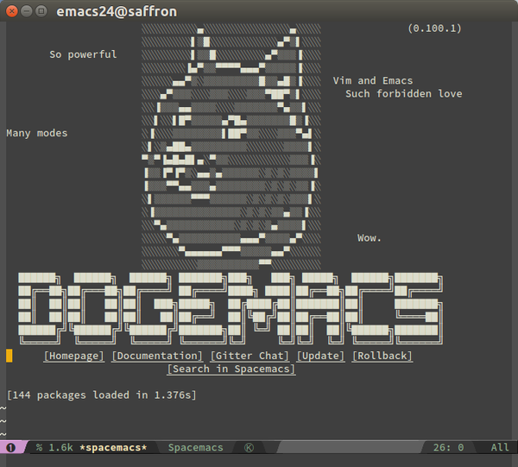

Tooling IDEs
Atom IDE-Haskell plugin set Syntax highlighting, autocomplete, errors, warnings, linting, hover-over type info
GHC-Mod Tool used by IDEs to provide autocomplete and type information
Emacs Haskell layers available
Notes:
Haskell may not have a Visual Studio or IntelliJ equivalent, but that doesn’t mean it’s bereft of editors. The IDE-Haskell set of Atom plugins makes Atom a competent Haskell editor. It has syntax highlighting, autocomplete, errors, warnings, linting and hover-over type information.
The intelligence behind the autocomplete and type information that these plugins surface is from a Haskell tool called GHC-Mod that the Atom plugins will use behind the scenes.
Most of the team develops using Atom, but one of the team members flies the Emacs flag and uses Spacemacs. There are layers available for that editor that give it similar functionality to the Atom plugins, though he’s found them less stable, but there’s lots of people in the Haskell community working on improving it.
Lightweight editors are more popular these days so the lack of a Visual Studio equivalent is less an issue, as people tend to prefer editors that start and run fast, though they might offer less features. Personally, I’m a fan of IDEs and tools like ReSharper, so I feel their loss keenly, but the pleasure of writing code in Haskell for me overcomes the reduced features in tooling.

Slide 23
Hello World in Haskell
Notes:
Let’s do a quick demo of how easy it is to get a Haskell project started.
stack new ndc-project
cd ndc-project stack setup
Show cabal file
Write hello world in Main.hs
stack build
stack exec ndc-project-exe stack install ndc-project-exe

Slide 24

Laziness
fromMaybe :: a -> Maybe a -> a
ghci> fromMaybe "Fallback" (Just "Value")
"Value"
ghci> fromMaybe "Fallback" Nothing
"Fallback"
Not evaluated unless actually used
let expensiveValue = primes 1000000 in fromMaybe expensiveValue maybeANumber
Notes:
Haskell is a lazy language, as opposed to the traditionally strict languages we normally use. This means you can write code in what appears to be an inefficient way from a strict language point of view, but since Haskell only evaluates what is necessary when it is actually needed, your code executes efficiently.
Laziness helps you subtly all over the place when writing Haskell. A simple example is the use of the fromMaybe function. fromMaybe takes a Maybe value and a fallback value and returns Maybe value if it exists, or the fallback value is the Maybe is Nothing. So the examples on the slide show that when Just Value is provided, fromMaybe returns Value, but when Nothing is provided, the Fallback value is returned.
To demonstrate laziness on the slide we’re using fromMaybe, and in a strict language, that expensiveValue would be evaluated before being passed to fromMaybe. So you’d pay the cost of calculating that fallback value even if it wasn’t going to be used. In Haskell, expressions are only evaluated when their value is required, so the millionth prime would only be returned if the Maybe was Nothing.

Slide 25
Laziness
fmap (transform each item in the list)
notSoExpensiveList =
let transformedList = expensiveTransform <$> bigList in take 5
. drop 100
$ transformedList
Read from bottom to top
Notes:
Here’s another example. Imagine we’re transforming each item in a big list with some expensive calculation. However, we only want the 101-105th elements from the list. In a strict language, we’d be paying the expensive transform cost for at least the first 100 list elements that we’re dropping before getting the 5 that we actually want. However, in Haskell, laziness ensures that the transform is done only when required and so when we eventually look at those 5 elements we’ve picked out of the list, the transform will be done then on those 5 elements only.
Laziness means you can write code more declaratively in a way that reads more cleanly, and only the parts that are needed are actually run.

Slide 26
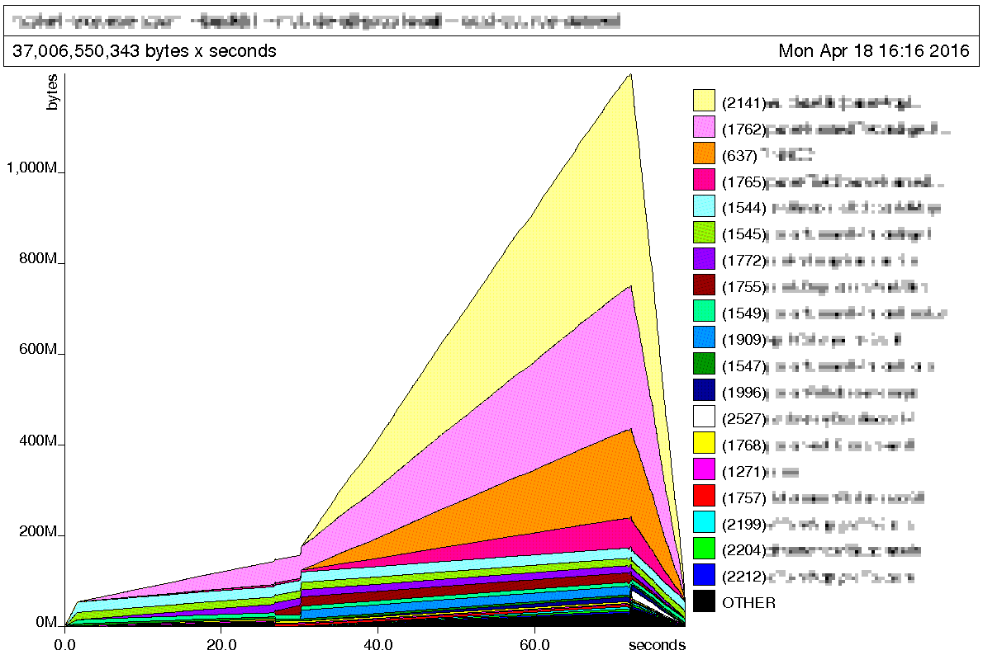

Space Leaks
data SeekJob = SeekJob
{ jobId :: JobId
, advertiserId :: AdvertiserId
, location :: Location }
loadJobs :: FilePath
-> Map JobId SeekJob
Notes:
However, laziness is a double edged sword. You gain execution efficiencies, but you can also get cut by a new type of memory leak: space leaks. This is where, because of laziness, you may retain things in memory longer than you expect because the code that would otherwise decide to drop that memory hasn’t actually run yet.
We had an issue where we loaded a lot of jobs from a CSV data source and put them in a map. Each CSV row contained far more information than we actually needed, so we only stored a few small columns in our record, which you can see on the slide. However, our program used a lot of memory for no apparent reason, even though we were keeping only a few fields from each row. You can see the chart the Haskell memory profiler generated for us on the slide.
What was happening was that each CSV row was being read in for parsing. However, when we set the properties on our records (such as jobId), the actual parsing of the row in memory to get our couple of fields was lazy. So until we actually needed the values of the properties on SeekJob (assigning them doesn’t count), parsing wasn’t done and so the memory holding what needed to be parsed was kept around. So the whole CSV was effectively kept in memory.

Slide 27
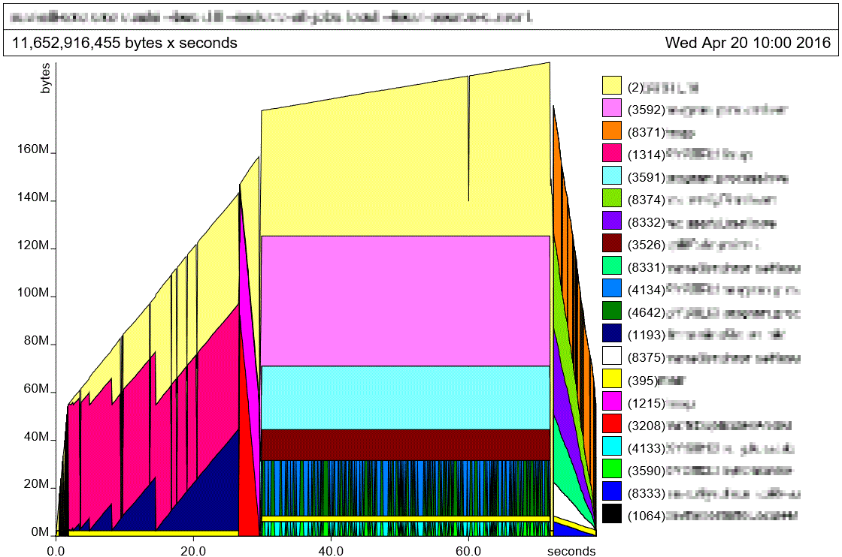


Space Leaks
data SeekJob = SeekJob
{ jobId :: JobId
, advertiserId :: AdvertiserId
, location :: Location }
loadJobs :: FilePath
-> Map JobId SeekJob
Notes:
We fixed this by forcing strictness on each SeekJob as we created it, which forced the evaluation of the parsing logic, which now complete, dropped the CSV row from memory. As you can see, we went from over a gigabyte in memory usage, down to around 180MB.
In my mind, this is the biggest downside of Haskell. Laziness, while often useful, also sometimes makes it hard to reason about the execution time and memory usage of code, so you need to keep an eye on it so you aren’t in for any surprises when you’re dealing with a large dataset or high load. However, I think it’s fair to say that for any application that will experience high load you should always be testing it under that load, so that requirement isn’t an unusual burden.

Slide 28

Property Tests
QuickCheck First-class property testing library for Haskell
Assert properties about your code Let QuickCheck generate data to verify that property
Introduction to Property-Based Testing bit.ly/prop-testing-intro (h/t @ScottWlaschin)
Notes:
Our project is heavily unit tested. The results of our work affect the candidate experience for millions of job seekers across Australia and New Zealand, so it needs to be correct! We also practice continuous deployment, so a commit to master automatically deploys to production, and our test suite is a part of what gives us the confidence that our changes are okay to ship. Haskell also has the first-class QuickCheck library that lets you write property tests. Property testing is where you assert properties about your code and the test will automatically generate data to feed your code and test that that property holds for hundreds of different permutations of input.
Scott Wlaschin has a great set of articles on his website that is super useful as an introduction to property based testing; you should definitely check out that series.
We’ve used this technique at the unit level, but also at the entire program level, where we’ve generated input data for the program and then asserted that for each piece of input data, we expect one or more log entries to be outputted for it. We’ve become so confident in our test coverage, our team’s QA sacked himself and moved to a different team who needed his help more than we did.

Slide 29
Property Testing Demo
Notes:
So let’s take a look at a simple example of property tests in Haskell.
Show added dependencies in cabal file
Explain how the splitSpaces function works
Explain the property tests
Run the tests
Use the broken version and demonstrate failure

Slide 30

Haskell or the Highway? Consider Haskell if…
You’ve done some FP before You enjoy FP, and get frustrated with the OO-bits of
your FP-hybrid language
You ❤ purity & immutability You’ve seen how useful these are and want more
You’re willing to learn new things Haskell is very different, but is rewarding and absolutely
within reach
You need correctness and clarity Correctness and clarity of code are paramount to you
Notes:
So am I saying that if you want to do functional programming, you should use always use Haskell if you want to be a real functional programmer? No! I would never say that Haskell should be used in all situations, and I’d never say that about any specific technology. Unfortunately, the world is not black and white and your personal requirements may be different to mine. If you don’t feel ready to go whole hog on functional programming, purity & immutability and would like to stay in familiar .NET or Java-land, both F# and Scala are competent languages and I encourage you to use them.
With that said, I think you should consider Haskell if you’ve done some FP before in a hybrid language and you’re loving it, but are getting frustrated when you have to cross over into the mutable OO part of the language.
If you’ve seen how useful purity and immutability are and want more, then Haskell might make you very happy.
Haskell is quite different, but if you’re willing to learn new things, then it is extremely rewarding and absolutely within reach for those who have the patience to learn.
If correctness and clarity are of paramount importance to you, then Haskell is a good choice, as you can express intention in a clear declarative style.

Slide 31
Haskell or the Highway? What’s Haskell good for?
✓
Data parsing and processing Haskell’s declarative style and parsing libraries
make this a pleasure
∼
SQL Databases PostgreSQL is popular, but MSSQL or Oracle is not
✓
Complex algorithms Easy to construct DSLs to make code understandable
✗
GUI Desktop Applications GTK libraries exist, but forget about WPF/XAML
✓
Web Services Haskell has great libraries for creating and consuming
web services and dealing with HTTP and JSON
State of Haskell Ecosystem bit.ly/haskell-sotu (h/t @GabrielG439)
✓
Scripting and Command-Line Statically-typed but with powerful type inference and
first-class command-line argument parser libraries
Notes:
So what sort of applications are good in Haskell? Well, any time you’re wanting to do some data parsing and processing, Haskell’s a great choice. It’s declarative style and great parsing libraries make that sort of problem a pleasure to solve.
Any program with complex algorithms is going to be great to write in Haskell as you can easily write DSLs to make the code understandable and the type system and stellar testing capabilities make ensuring correctness easy.
Programs that consume web services or are web services are well supported in Haskell. There are great libraries available for dealing with HTTP and JSON.
Scripts and command-line programs are great to write in Haskell. Scripts can often grow out of control, but Haskell’s static typing and its type inference helps keep your scripts correct but still concise. Haskell also has the best command line argument parser library I’ve ever used.
However, Haskell is not suited for everything (yet). SQL Databases are a surprising weak point. If you’re wanting to use PostgresSQL, you’ll be fine, but major databases like SQL Server and Oracle have some support but apparently it’s not perfect. We haven’t had to use SQL databases on our project, so this hasn’t been a problem for us.
GUI desktop applications are also not Haskell’s forte. There are libraries that help you write GTK apps, but forget about WPF and XAML.
The “State of the Haskell Ecosystem” document that Gabriel Gonzales keeps up to date on GitHub is a good place to look to see whether your particular problem is well suited to Haskell.

Slide 32




Who else is using Haskell?
Notes:
So who else in industry uses Haskell in production? The highest profile use I know of is at Facebook’s where they use Haskell to fight spam. They developed the Haxl data access framework that allows them to quickly and efficiently access the data they need to figure out whether posts are spam. Facebook have done a number of presentations about this, which you’ll be able to find recordings of if you Google for it.
Helium is an IoT startup that offers a range of sensors that report data into the cloud for analysis. They use Haskell on the server side; Reid Draper is an engineer at Helium and he did a talk on their use of Haskell at YOW 2015 that you can find on YouTube.
CircuitHub is a company that wants to be the AWS of manufacturing and their software lets you get instant quotes on parts, PCBs and assembly and then get your product manufactured. Their core services and algorithms are written in Haskell.

Slide 33
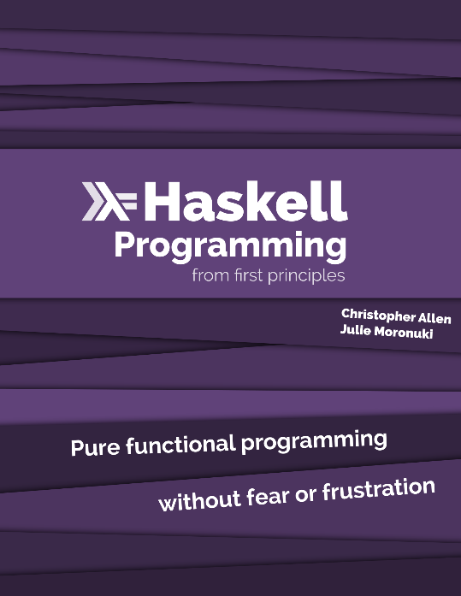


Learning Resources
Maybe Haskell Small book with pragmatic examples of why you should care about FP and Haskell
/r/haskell Good place to see what’s going on in the community and ask questions
haskellforall.com Gabriel Gonzalez’s blog
haskellbook.com
learnyouahaskell.com
Notes:
If you want to learn Haskell, I highly recommend the Haskell Programming from First Principles book. It starts from the beginning, goes into sufficient detail and doesn’t gloss over things, and has exercises that you can do if you want to cement concepts in your head. At SEEK we’re running a internal weekly lunchtime reading group where we go over the answers to the exercises from the book.
Learn You a Haskell for Great Good is book you can read for free online, so if you’re looking for a free alternative, that’s a good one to look at. However, it does contain some mathsy bits, which can be a little confusing to those unfamiliar.
Maybe Haskell is a small book that has some pragmatic examples of why you should care about FP and Haskell. The Haskell subreddit is a good place to ask questions and see what’s going on in the community. Obviously Stack Overflow is good too. Also Gabriel Gonzalez’s blog, Haskell for All is a good one to follow.

Slide 34

Questions?
Slides and Code bit.ly/haskell-in-prod
Twitter @danielchmbrs
Notes:
So hopefully I’ve convinced you to take a look at Haskell and to realise that Haskell isn’t that scary when you take the time to learn it properly. None of the team at SEEK had any experience in Haskell when we started our project, and now we’re shipping Haskell code to AWS in production. We think that Haskell is an awesome language in which to write clean, pure, immutable code, and I encourage people who love functional programming to investigate it for themselves.
I’ve put the slides and code up on GitHub, the link is up on the slide. I’m on Twitter so feel free to contact me there or if you see me around at the conference. I’m happy to take any questions now if you’ve got some.

